Slide 1

Traffic Sign Recognition System
Presented by Guided by
Aswathy I Prof. Natheera Beevi M
TKM23MCA-2022
Date : 08/11/24

Slide 2

INTRODUCTION
TRAFFIC SIGNS INCLUDE A WIDE RANGE OF SYMBOLS AND INSTRUCTIONS, MANY OF WHICH ARE NOT COMMONLY UNDERSTOOD BY THE GENERAL PUBLIC.
ENCOUNTERING UNFAMILIAR TRAFFIC SIGNS OFTEN LEADS TO DRIVERS IGNORING THEM, WHICH CAN RESULT IN ACCIDENTS.
TSR SYSTEMS ENHANCE DRIVING SAFETY BY MITIGATING THE RISKS ASSOCIATED WITH MISINTERPRETING OR OVERLOOKING TRAFFIC SIGNS.
THE DATASET USED IS GERMAN TRAFFIC SIGN RECOGNITION BENCHMARK (GTSRB) DATASET WITH 50,000 IMAGES, THE MODEL IS TRAINED TO RECOGNIZE 43 DIFFERENT SIGNS.

Slide 3
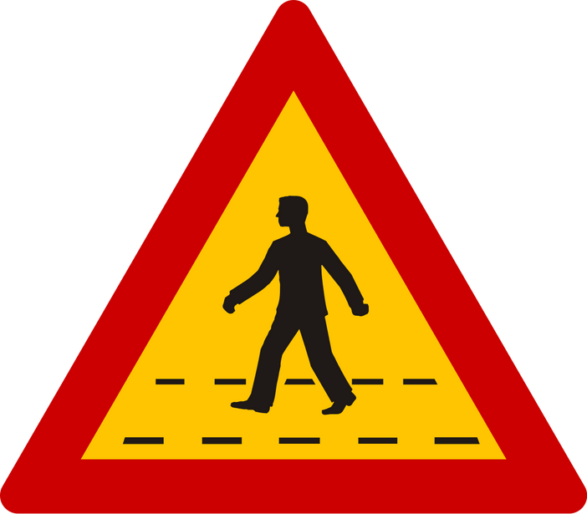
PROBLEM STATEMENT
THE OBJECTIVE IS TO DEVELOP A TRAFFIC SIGN RECOGNITION (TSR) SYSTEM MODEL UTILIZING DEEP LEARNING MODELS LIKE CNN, ALEXNET AND VGG19 ALGORITHM AND FINDING THE BEST MODEL.
THIS SYSTEM AIMS TO SIGNIFICANTLY ENHANCE RECOGNITION ACCURACY AND REDUCE PROCESSING TIME, ULTIMATELY IMPROVING THE CORRECT RECOGNITION RATE OF TRAFFIC SIGNS.

Slide 4
LITERATURE REVIEW
AUTHORS | TITLE | PUBLISHED YEAR | Models Used | Source
Xiaoxuan Qiao | Research on Traffic sign recognition based on CNN Deep Learning Network | 2023 | CNN | 3rd International Conference on Machine Learning and Big Data Analytics for IoT Security and Privacy
Di Zang , Zhihua Wei, Maomao Bao , Jiujun Cheng, Dongdong Zhang, Keshuang Tang , Xin Li | Deep learning–based traffic sign recognition for unmanned autonomous vehicles | 2018 | CNN,ResNet, AlexNet | IEEE 17th International Conference on Intelligent Transportation Systems (ITSC)

Slide 5
GAPS IDENTIFIED
Prior research used only CNN, which is foundational for image recognition but lacks advanced feature extraction capabilities.
CNN models can struggle with complex patterns in traffic signs, impacting their overall accuracy.

Slide 6
PLAN TO SOLVE THE PROBLEM
OBJECTIVE: DEVELOP A SYSTEM THAT IMPROVES UPON BASIC CNN LIMITATIONS BY ACCURATELY DETECTING AND CLASSIFYING ROAD TRAFFIC SIGNS THROUGH ADVANCED DEEP LEARNING MODELS.
APPROACH:
CONVOLUTIONAL NEURAL NETWORKS (CNNS) : TRAIN A CNN MODEL FOR TRAFFIC SIGN RECOGNITION.
ALEXNET & VGG19 : IMPLEMENT AND EXPERIMENT WITH BOTH MODELS.
COMPARE ALL MODELS BASED ON ACCURACY AND FIND THE BEST MODEL.
PREDICT USING ALL MODELS.

Slide 7
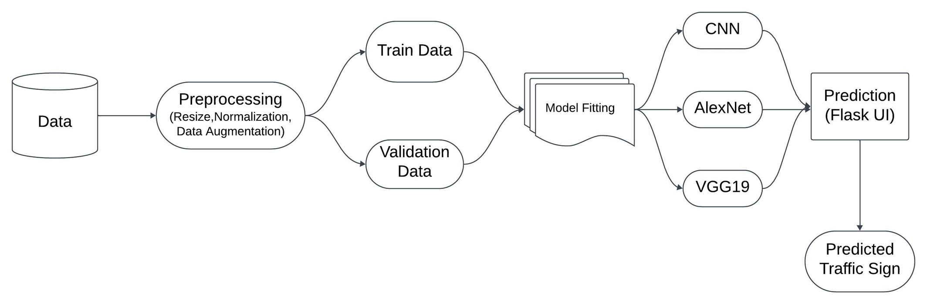
BLOCK DIAGRAM

Slide 8
METHODOLOGY
DATA COLLECTION - GTSRB - GERMAN TRAFFIC SIGN RECOGNITION BENCHMARK WHICH CONSISTS OF 43 DIFFERENT TRAFFIC SIGNS COMMONLY FOUND ON GERMAN ROADS.
THE TRAFFIC SIGN IMAGES ARE CROPPED FROM ACTUAL ROAD IMAGES AND ARE THEREFORE UNDER DIFFERENT LIGHTING CONDITIONS, WITH A TOTAL OF 50,000 IMAGES.
DATA PREPROCESSING - RESIZING, NORMALIZATION AND DATA AUGMENTATION ARE APPLIED.
MODEL SELECTION - CNN, ALEXNET, VGG19.
MODEL TRAINING

Slide 9


DATASET - SAMPLE
SPEED LIMIT - 80 KM/HR SLIPPERY ROAD

Slide 10
RESULTS
Model | Training Accuracy | Validation Accuracy
CNN | 99.23% | 99.64%
AlexNet | 99.95% | 99.69%
VGG19 | 99.98% | 99.87%

Slide 11
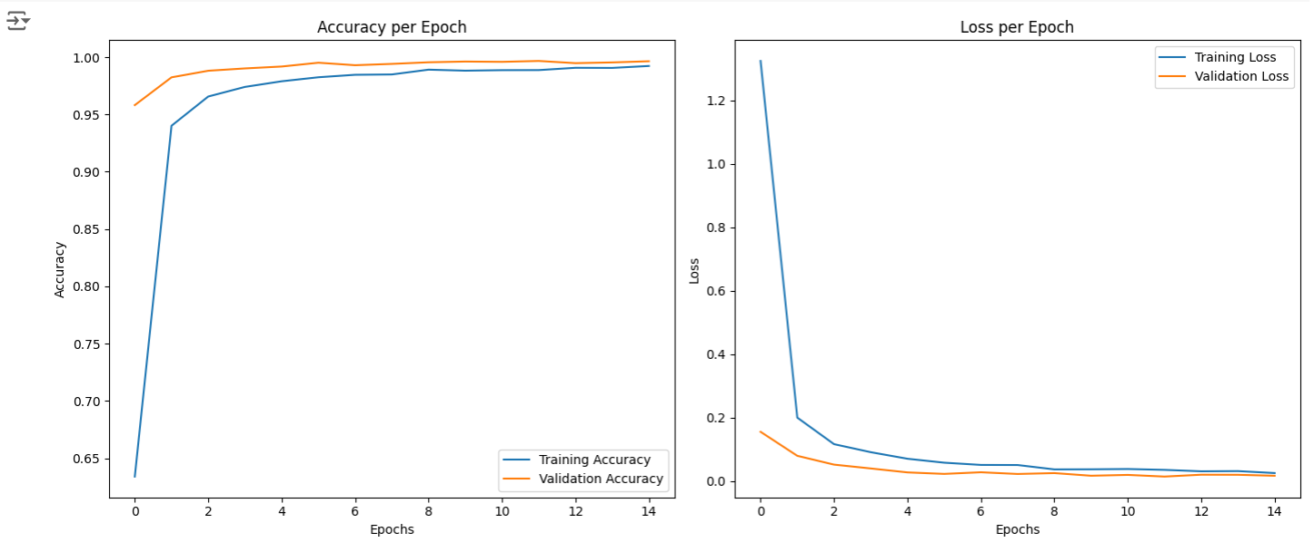
EVALUATION CURVES - CNN

Slide 12
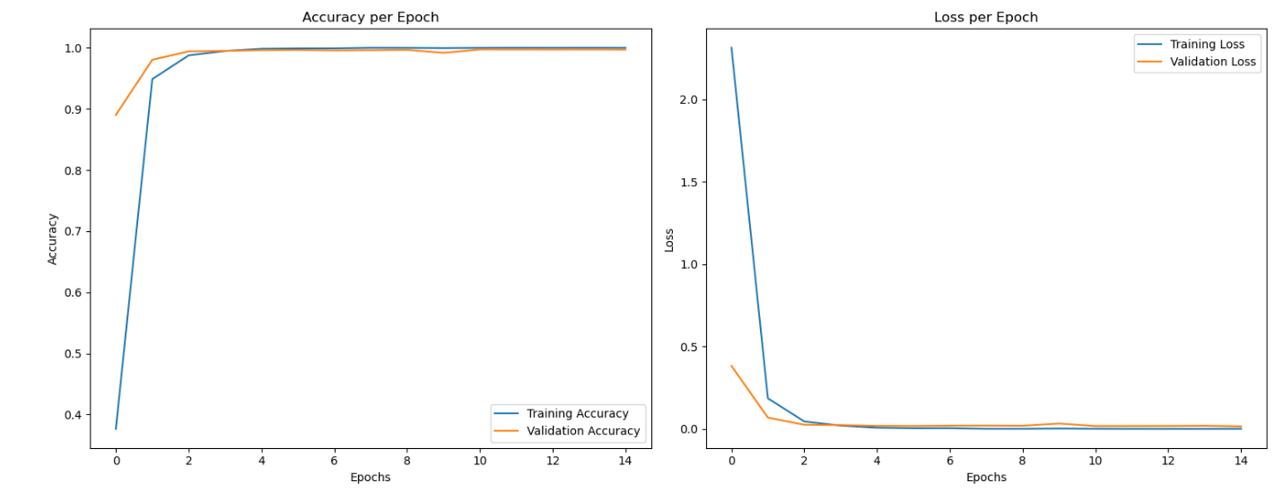
EVALUATION CURVES - ALEXNET

Slide 13
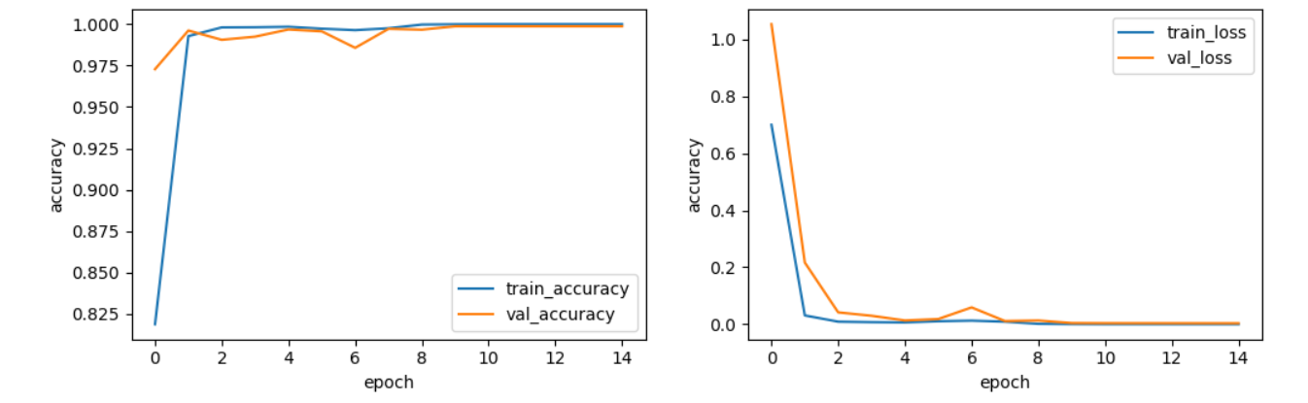
EVALUATION CURVES - VGG19

Slide 14
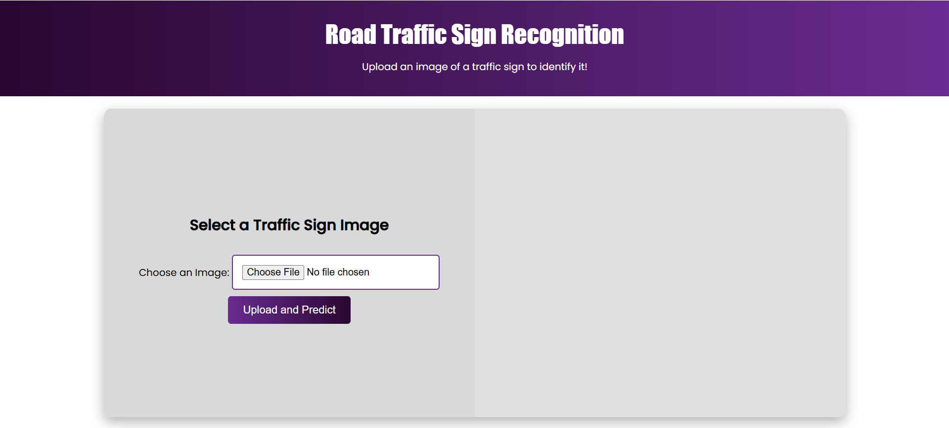
SCREENSHOTS

Slide 15
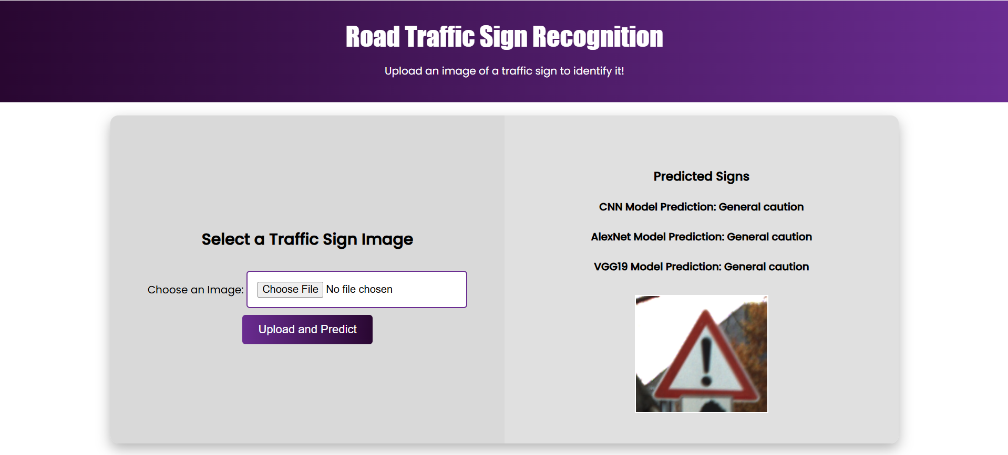
SCREENSHOTS

Slide 16
FUTURE SCOPE
HYBRID MODEL WITH NLP FOR TEXT-BASED SIGNS: MANY TRAFFIC SIGNS INCLUDE TEXT (E.G., “SPEED LIMIT 60”). COMBINE YOUR CNN-BASED MODEL WITH NATURAL LANGUAGE PROCESSING (NLP) TO RECOGNIZE AND INTERPRET TEXT ON SIGNS ACCURATELY, EXPANDING THE SYSTEM'S ABILITY TO HANDLE COMPLEX SIGN TYPES.
IOT VEHICLE DEMO WITH REAL-TIME DETECTION AND VOICE ALERTS: DEPLOY THE SYSTEM ON IOT-ENABLED DEMO VEHICLES TO CAPTURE AND PREDICT TRAFFIC SIGNS IN REAL TIME, PROVIDING VOICE ALERTS FOR DRIVER ASSISTANCE AND SHOWCASING IOT AND AI INTEGRATION FOR ROAD SAFETY.

Slide 17
Thank you!

